Slide 1
Consider building
Approaching financial applications with quantum resources
Luna Zhang @ QST-HACK2025

Slide 2
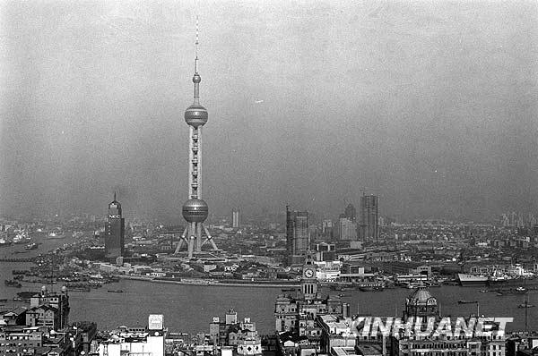
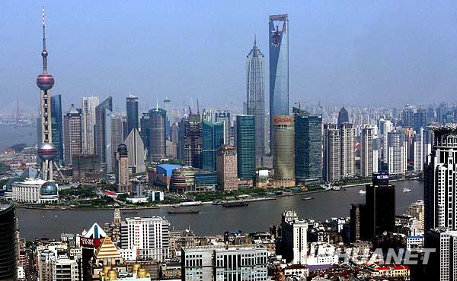
Lujiazui, the financial district in Shanghai
1995
2008
Notes:
I was 13 years old when the financial district
Lujiazui is Shanghai's gleaming financial district, located in Pudong, featuring iconic skyscrapers like the Oriental Pearl Tower, Shanghai Tower, and Shanghai World Financial Center that define the city's famous skyline along the Huangpu River.

Slide 3
Growth does not just happen
Scientific progress is not to be taken for granted. Nor is value created.
“Discoveries, like the laser, create huge amounts, absolutely huge amount, trillions of dollars worth of new income that did not exist before. The laser, when it was discovered, was said to be a solution in search of a problem. It took 20 years before people finally decided that this was a major discovery.” —Donald Braben*
He is a physicist and throughout the 80s ran BP's Venture Research program.
Credit: mappingignorance
Notes:
Scientific progress is not to be taken for granted.
British Petroleum through the '80s, whose aim was to enable researchers who would otherwise have difficulty obtaining funding through traditional means
Science and technological advancement are the reasons for the prosperity shared by humanity, however it is not to be taken for granted. Ever wonder what happens in those twenty years?

Slide 4
Wonder what happens in those years?
Notes:
A lot of work is done

Slide 5
A lot of work!
Credit: mappingignorance

Slide 6
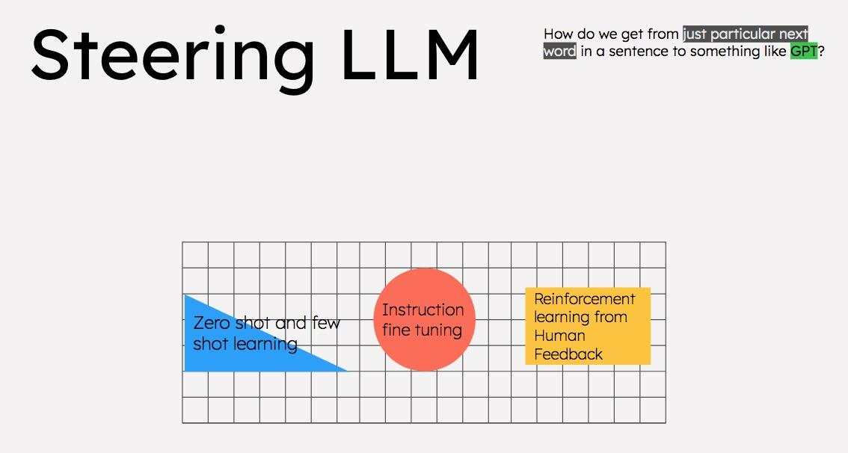
Take the example of LLM
Credit: mappingignorance

Slide 7
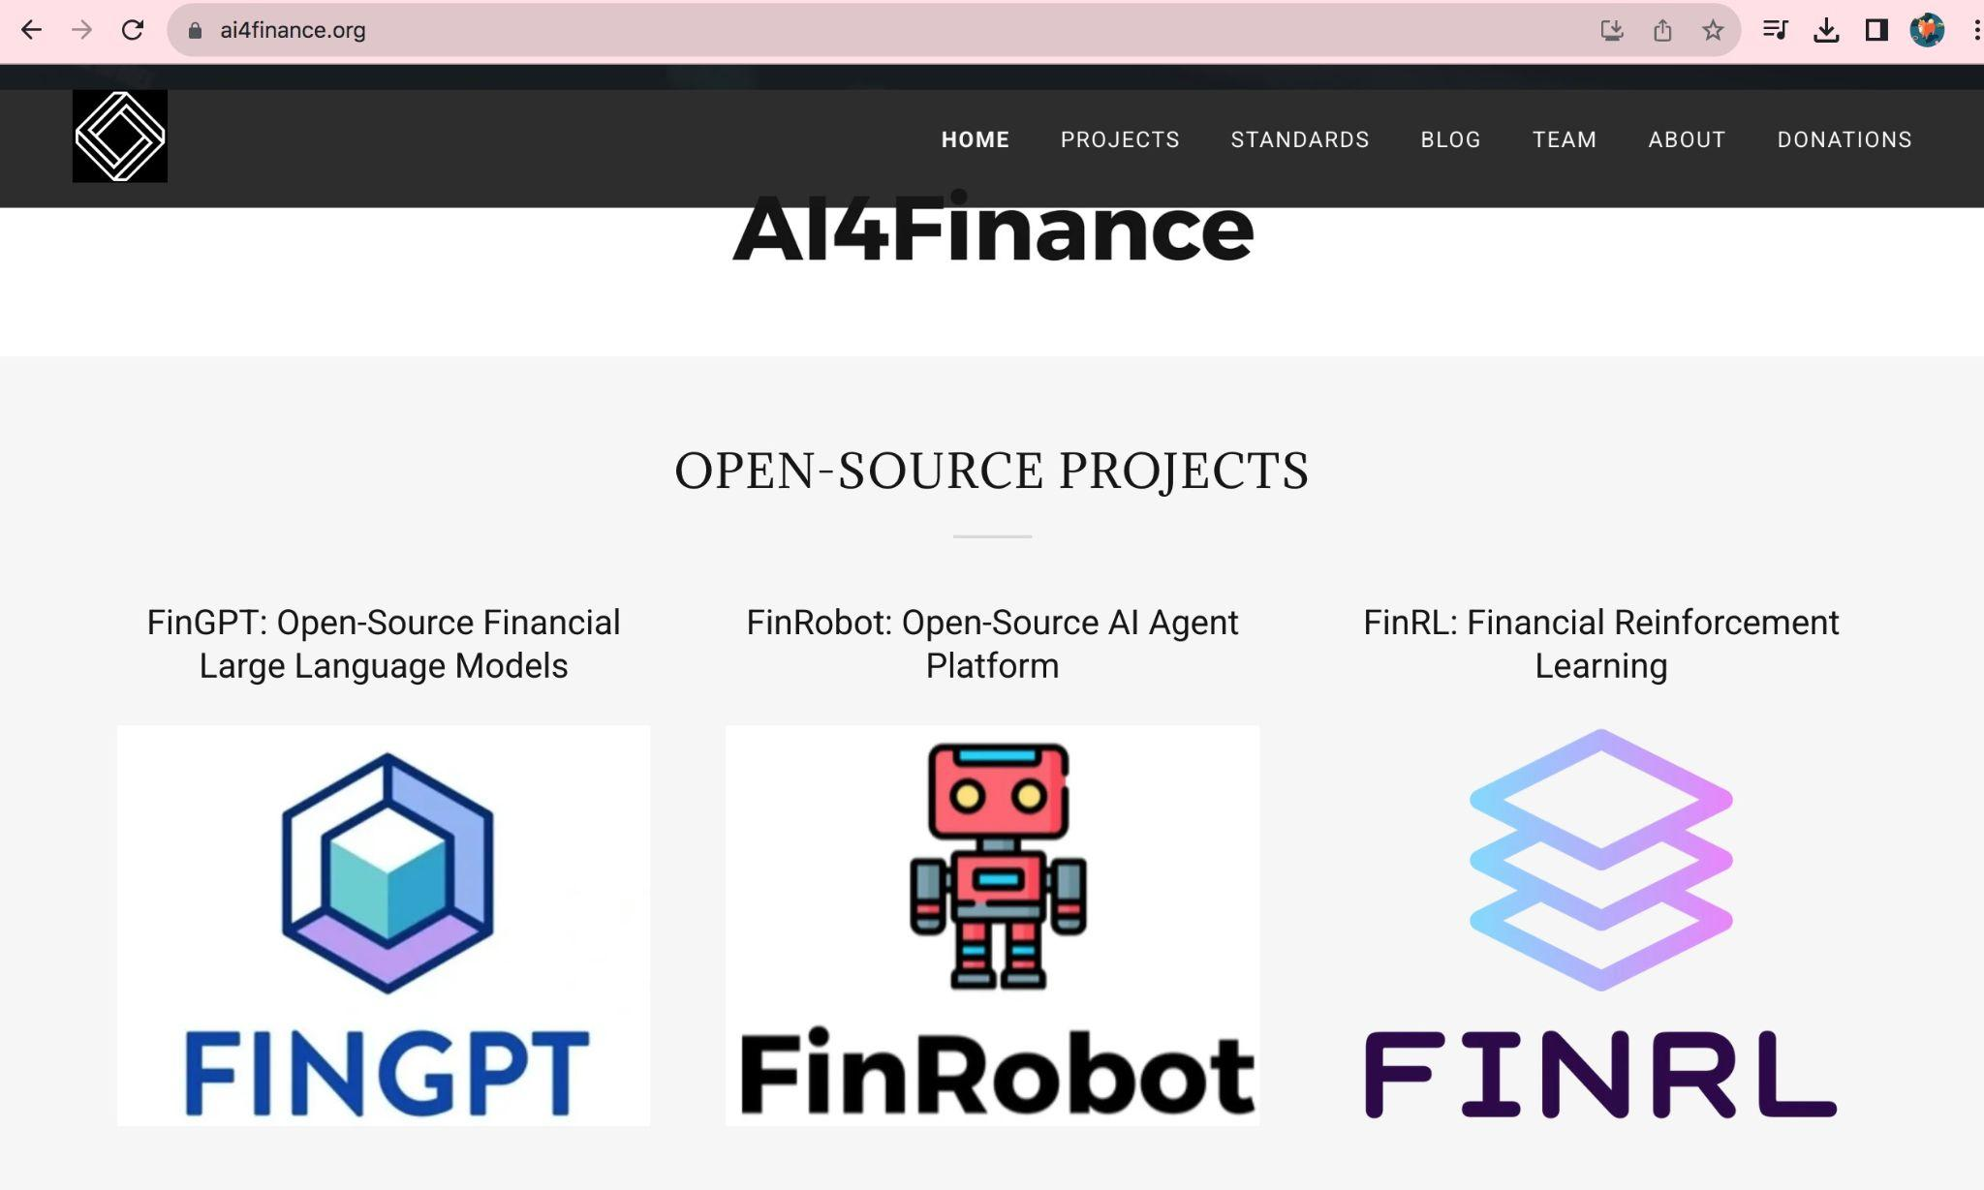
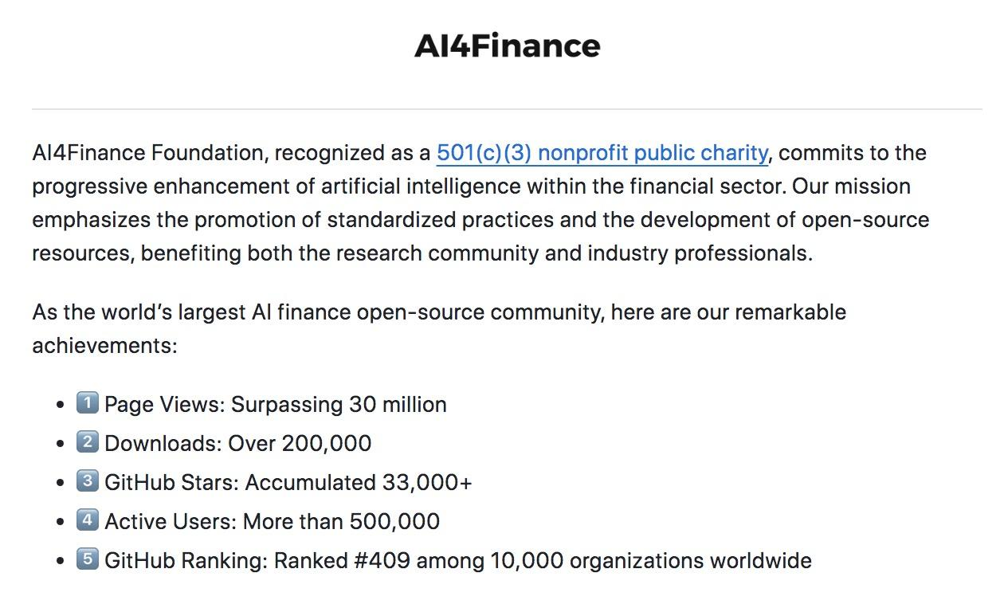
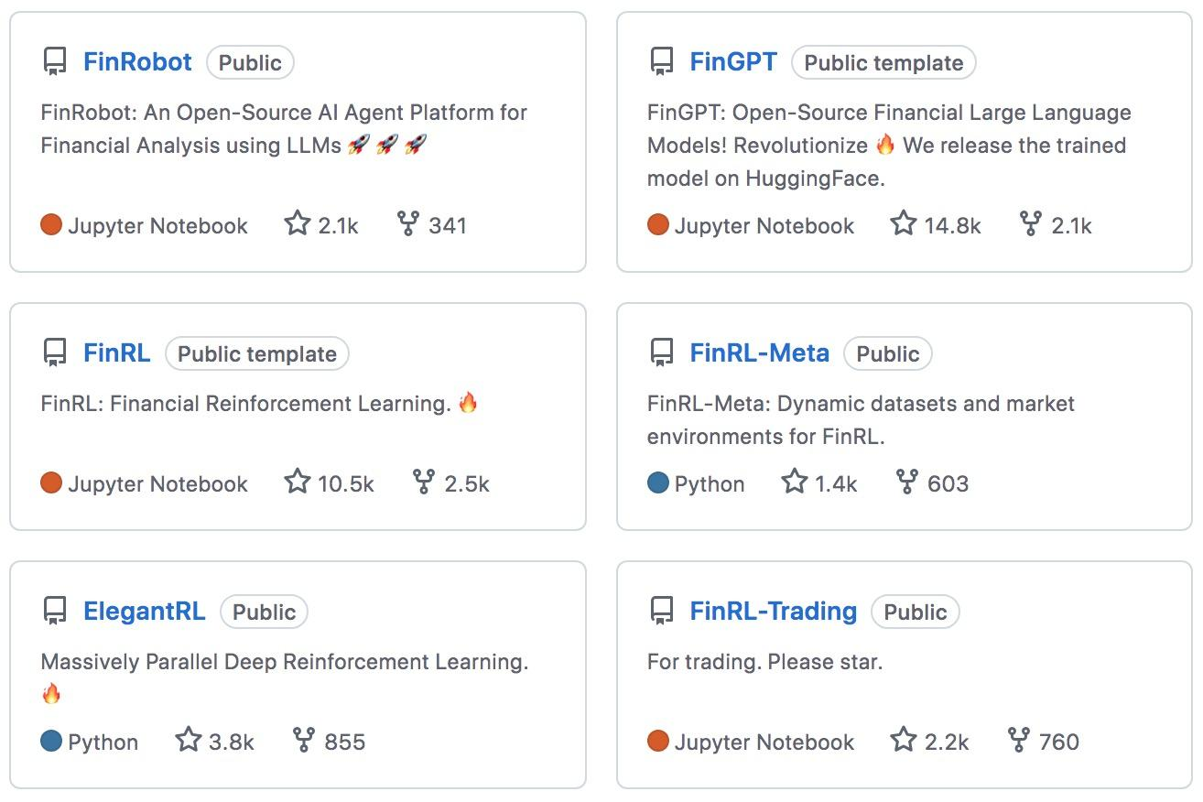
From chatGPT-alike to finGPT

Slide 8
Better cybersecurity needed
Because we would like to enjoy secrecy.
The world is highly digitized; it increases to be so.
Critical infrastructure is to be shared. How to encrypt messages on public channel?
Thanks to fellow folks working hard to boost quantum computing …
Notes:
Cybersecurity

Slide 9

Quantum key distribution
Credit to: Maylee for Quanta Magazine
Credit: mappingignorance

Slide 10
QKD milestones
BB84
(EB)E91
(1992)
Quantum resources used
Polarization states of single photons, switching basis
Entangled qubits, Bell inequality violation
Prepare and measure equivalence to EB
Early stages
No - cloning
Entanglement.nonlocality
arXiv:2501.12801 [quant-ph]
Notes:
Info-theoretical security
QKD was first suggested as BB84 protocol in (Ben- nett and Brassard, 1984) using polarization states of sin- gle photons as qubits (quantum bit states, generally be- ing in superpositions of the two basis states). By using non-orthogonal states and relying on the no-cloning the- orem, which forbids perfect copying of unknown quan- tum states (Wootters and Zurek, 1982), the protocol en- ables the trusted (honest) parties to ensure the security of the key, obtained from polarization encoding and mea- surements, and processed over an authenticated classi- cal channel. By randomly switching the preparation and measurement bases, the trusted parties accumulate the so-called raw key, which is then sifted during the bases reconciliation stage and is further classically processed to obtain the secret key.
Since Eve ideally cannot distinguish be- tween P&M and EB versions of the protocols, the lat- ter became not only a technical alternative, but also an ansatz for theoretical security analysis, as we discuss in

Slide 11
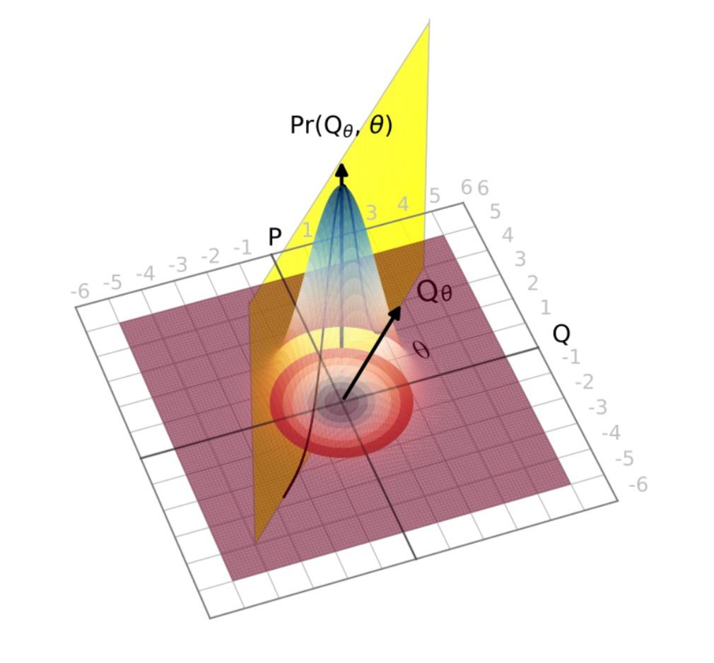
Quantum resources used/relaxed
QKD milestones
1999
2002
Access to classical resources
2003
2009
coherent states/squeezed state
homodyne detection/single photon detection
Continuous Variables
Quadrature observables measured with homodyne detection with squeezed states
Gaussian CV-QKD protocol with coherent states
Reverse reconciliation
allows channel attenuation at any level
generated keys to be used with encryption methods
Discrete modulation
arXiv:2501.12801 [quant-ph]

Slide 12
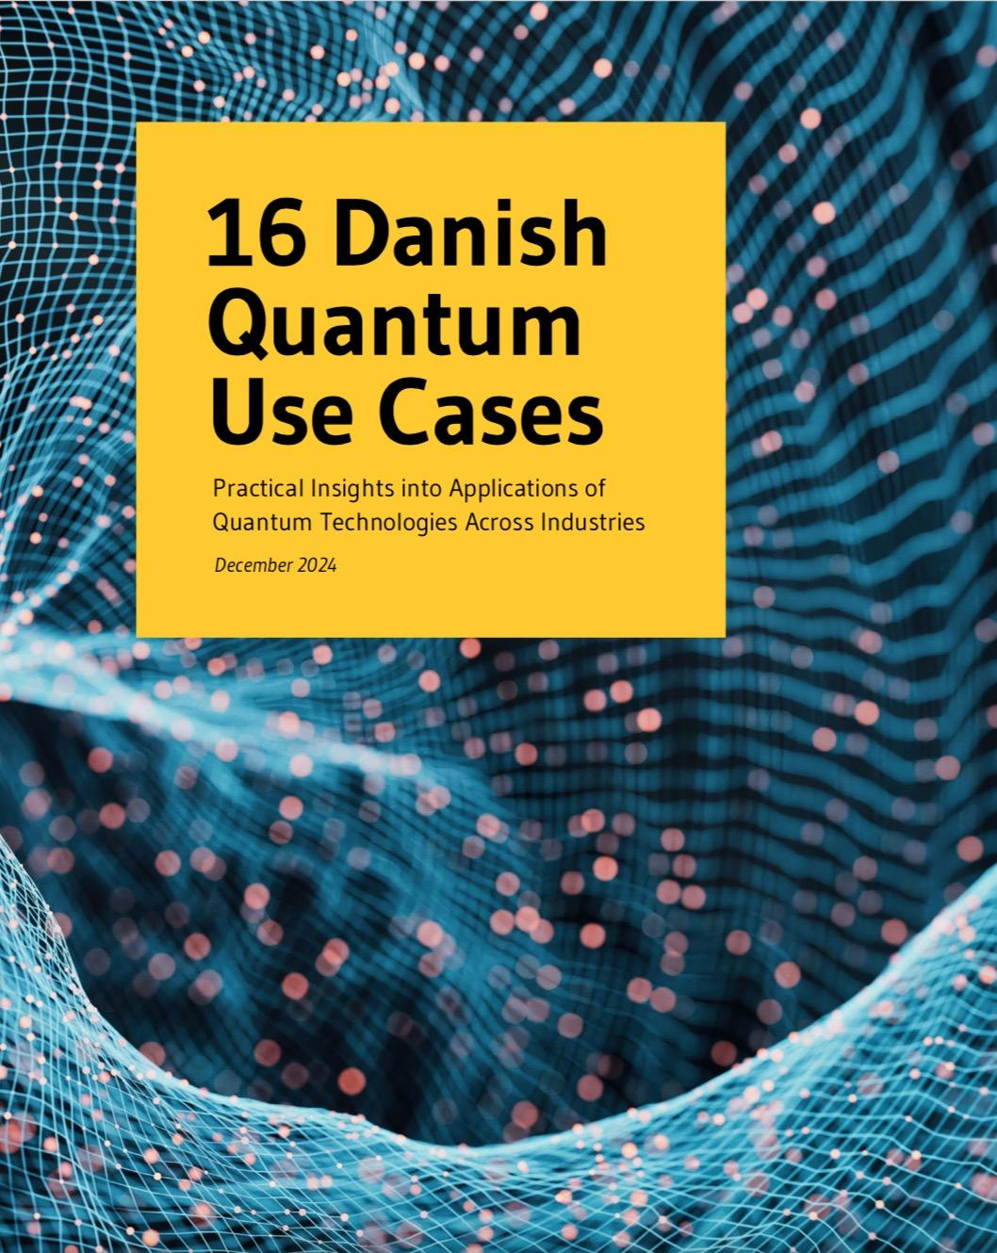
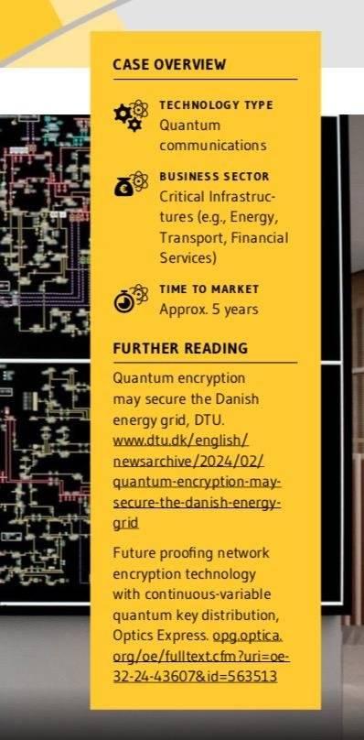
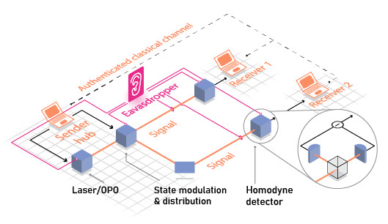
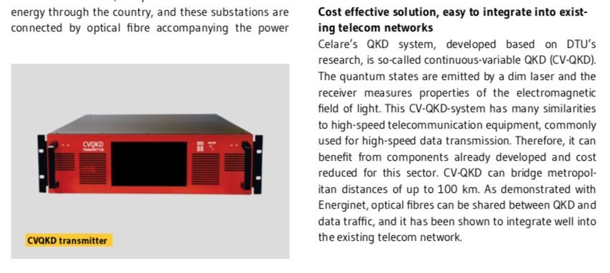
Continuous-variable QKD.
Composability
Discrete modulation
Finite size effect
Multi-user
Value:
Efficiency,
Cost,
Scalability,
Compatibility
Credit to: Ivan Derkach

Slide 13
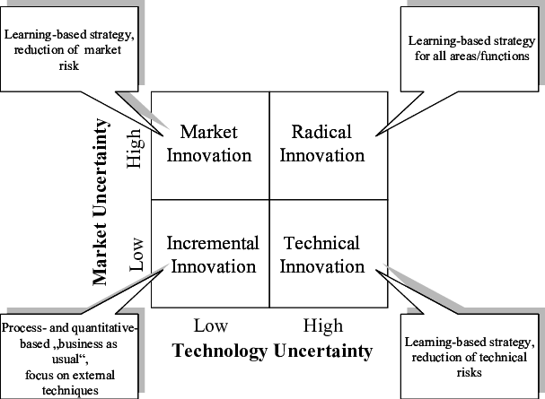
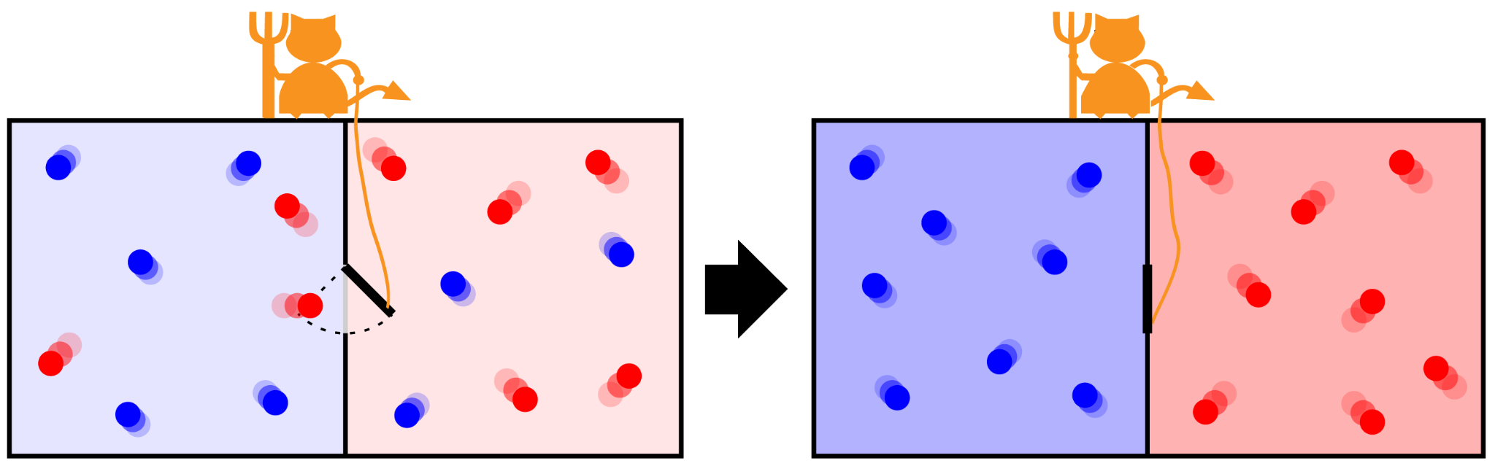
Information is physical.
Resource:
Information
You use information to work the physical world.
Credit: mappingignorance

Slide 14
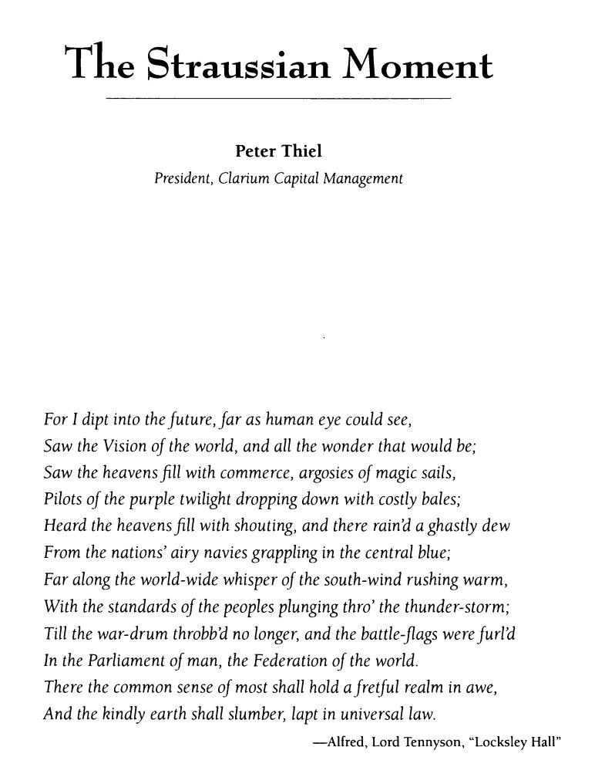
Can we approach building as we approach physics?
Resource:
Funding
Credit: mappingignorance

Slide 15
Thank you for your attention!
Any questions?

